Slide 1
Heart disease CLassification Use case

Slide 2

Artificial Intelligence Overview
a wide-ranging branch of computer science
has transformative potential across industries, revolutionizing how we work, live, and interact with technology .
building smart machines capable of performing tasks that typically require human intelligence,
Notes:
AI is a computer science field that involves creating smart machines or systems that mimic human behavior , tackling tasks that typically require human intelligence. its the revolutionizing the way we work live , and interact .

Slide 3
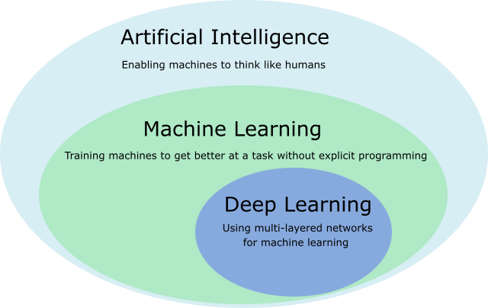
2. Machine Learning Overview
Learning = Improving with experience at some task
Machine learning :
Subset Of Artificial Intelligence
a way for computers to learn from data and make decisions or predictions without being explicitly programmed for each task.
Notes:
AI is a computer science field that involves creating smart machines or systems that mimic human behavior , tackling tasks that typically require human intelligence. its the revolutionizing the way we work live , and interact .

Slide 4
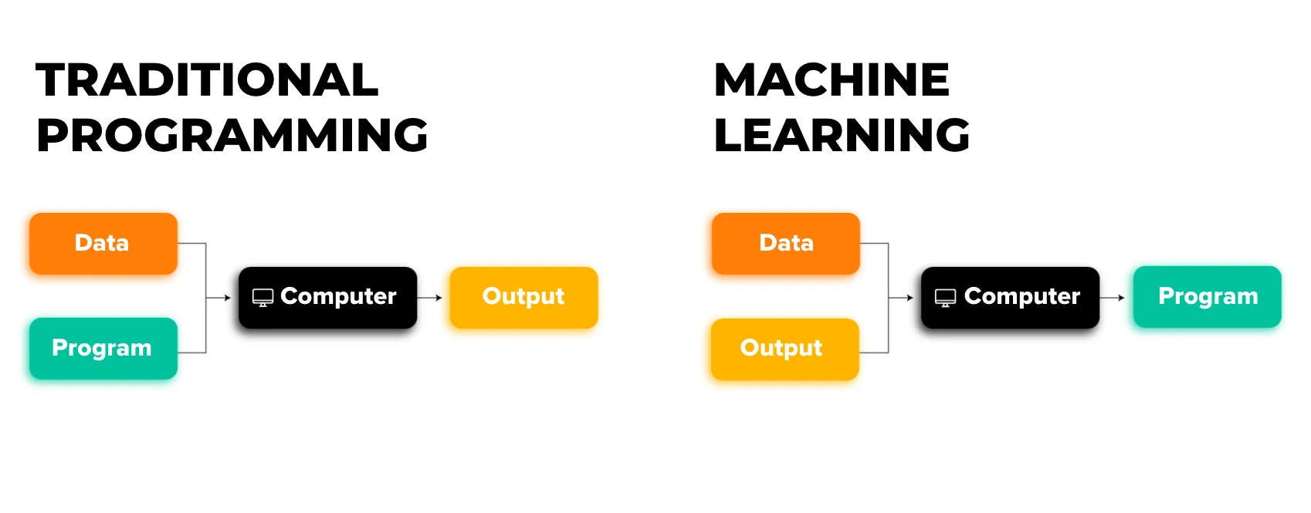
Notes:
AI is a computer science field that involves creating smart machines or systems that mimic human behavior , tackling tasks that typically require human intelligence. its the revolutionizing the way we work live , and interact .

Slide 5
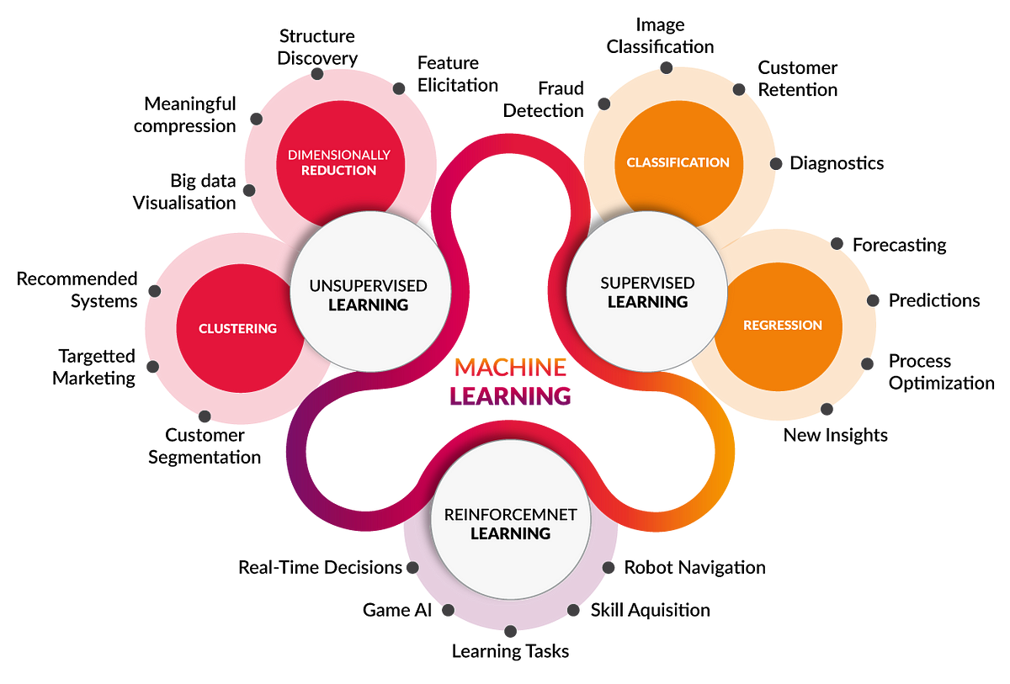
Machine Learning Categories
Supervised Learning: Learning from labeled examples.
Unsupervised Learning: Finding patterns in unlabeled data.
Reinforcement Learning: Learning from feedback by trying actions and seeing what works best.
Notes:
AI is a computer science field that involves creating smart machines or systems that mimic human behavior , tackling tasks that typically require human intelligence. its the revolutionizing the way we work live , and interact .

Slide 6
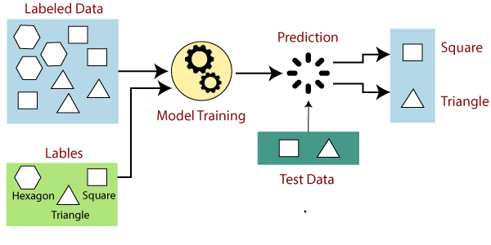
Supervised Learning
Notes:
AI is a computer science field that involves creating smart machines or systems that mimic human behavior , tackling tasks that typically require human intelligence. its the revolutionizing the way we work live , and interact .

Slide 7
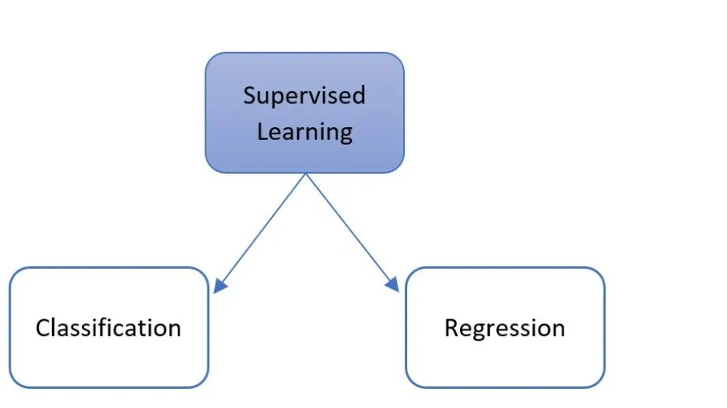
Supervised Learning
Classification : Assigning categories to input data.
Spam detection in emails.
Sentiment analysis in text (positive, negative, neutral).
Image classification (identifying objects in images).
Regression: Predicting continuous outcomes.
Predicting house prices based on features like size, location, etc.
Forecasting stock prices.
Estimating the temperature based on weather variables.
Notes:
AI is a computer science field that involves creating smart machines or systems that mimic human behavior , tackling tasks that typically require human intelligence. its the revolutionizing the way we work live , and interact .

Slide 8





3. Classification Use Case Using Machine Learning Workbench
Objective : Predict whether any person is suffering from heart disease.
Dataset : Heart-Disease Dataset from Kaggle
Tools used :
- Google colab notebook
- Python
- Data Factory Studio
- Machine Learning Workbench
- Data Perspective studio
Notes:
AI is a computer science field that involves creating smart machines or systems that mimic human behavior , tackling tasks that typically require human intelligence. its the revolutionizing the way we work live , and interact .

Slide 9
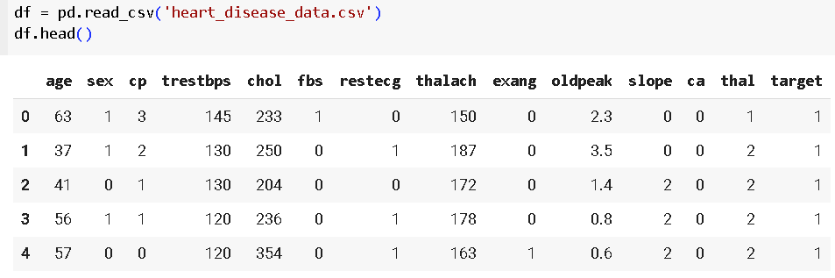
Exploratory Analysis
step 1: Importing Python Libraries
Numpy : numerical computing
Pandas : Data Manipulation and analysis
Matplotlib and seaborn: Plotting and creating visualizations
Scikit-learn: Machine learning tools
step 2 : Data Import
importing dataset and transform csv file into a pandas dataframe so we can manipulate it using pandas and numpy .
Notes:
AI is a computer science field that involves creating smart machines or systems that mimic human behavior , tackling tasks that typically require human intelligence. its the revolutionizing the way we work live , and interact .

Slide 10
Data Dictionary
Parameter | Definition | Variables
Age | age in years | integer
Sex | sex | 1 = male ,0 = female
cp | chest pain type : | Value 0: typical angina , Value 1: atypical angina Value 2: non-anginal pain Value 3: asymptomatic
trestbps | resting blood pressure (in mm Hg on admission to the hospital) | Float
chol | serum cholesterol in mg/dl | Float
restecg | resting electrocardiographic results | Value 0: normal Value 1: having ST-T wave abnormality (T wave inversions and/or ST elevation or depression of > 0.05 mV) Value 2: showing probable or definite left ventricular hypertrophy by Estes' criteria

Slide 11
Parameter | Definition | Variables
fbs | fasting blood sugar > 120 mg/dl | 1 = true; 0 = false
thalach | maximum heart rate achieved | Float
exang | exercise induced angina | 1 = yes 0 = no
oldpeak | ST depression induced by exercise relative to rest | Float
slope | the slope of the peak exercise ST segment | Value 0: upsloping Value 1: flat Value 2: downsloping
ca | number of major vessels (0-3) colored by flourosopy | Float
thal | thalassemia blood disorder | 0 = error (in the original dataset 0 maps to NaN's) 1 = fixed defect 2 = normal 3 = reversable defect
Target | the lable | 0 = no disease, 1 = disease

Slide 12
step 3 : Data Preprocessing
Handling missing values
Feature selection
Data normalization
Outliers removal
After this step, the data should be clean and ready for the modeling stage. Typically, I employ scikit-learn as my machine learning Python framework. However, for this project, the objective is to utilize Dassault Systèmes tools . Consequently, we will employ the machine learning workbench for the modeling phase.
3 classification algorithms can be used in Machine Learning Workbench :
Random Forest
XGBoost
Light GBM
Notes:
AI is a computer science field that involves creating smart machines or systems that mimic human behavior , tackling tasks that typically require human intelligence. its the revolutionizing the way we work live , and interact .

Slide 13
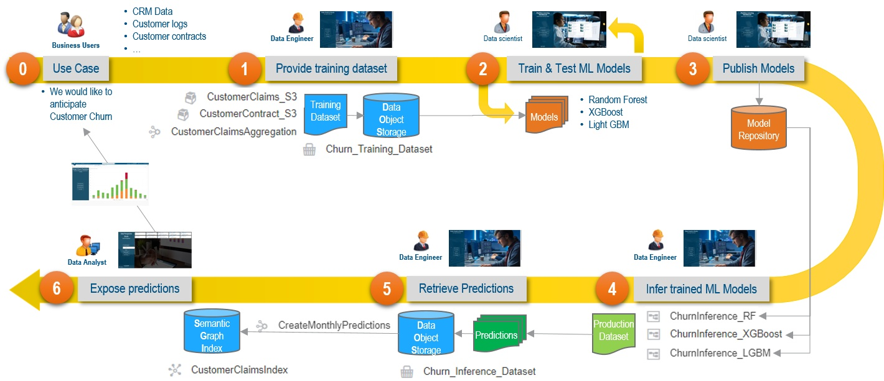
The workflow for our use case will be like in this example :
Notes:
AI is a computer science field that involves creating smart machines or systems that mimic human behavior , tackling tasks that typically require human intelligence. its the revolutionizing the way we work live , and interact .

Slide 14
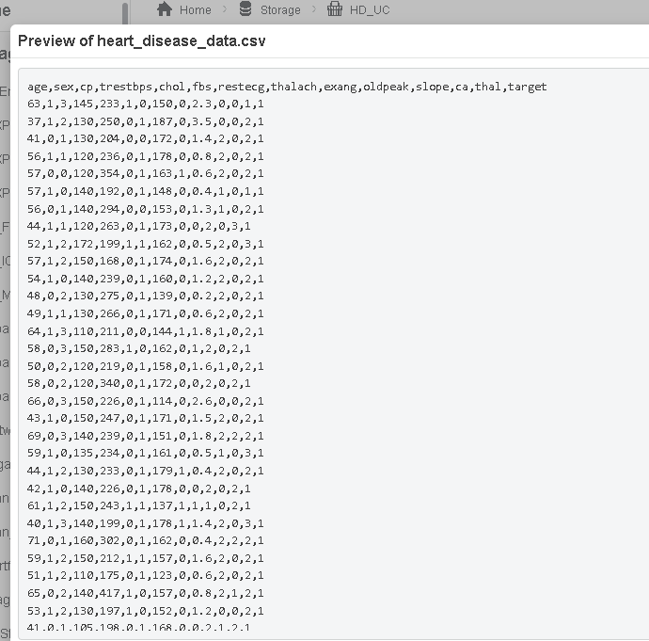
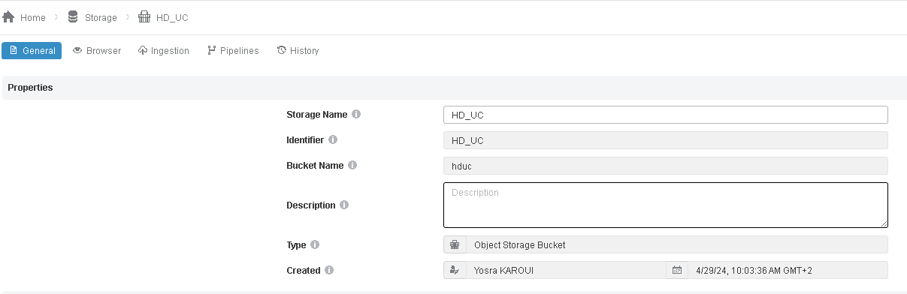
2. Use case implementation using Dassault systemes tools
In Data Factory studio , Create a new Bucket and import the dataset
Notes:
AI is a computer science field that involves creating smart machines or systems that mimic human behavior , tackling tasks that typically require human intelligence. its the revolutionizing the way we work live , and interact .

Slide 15

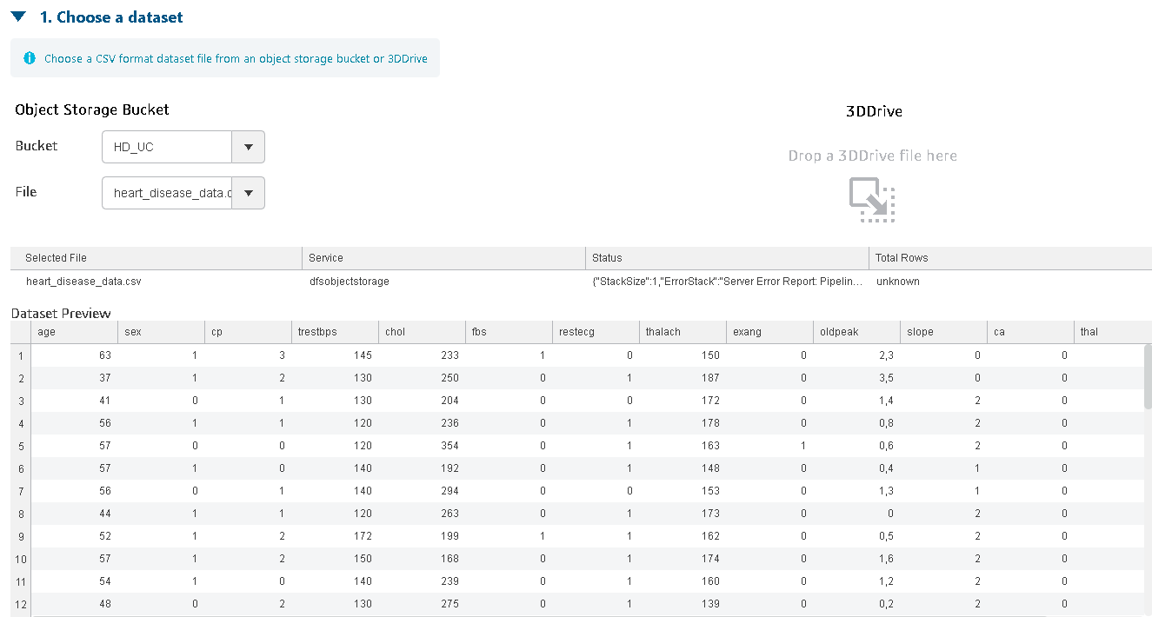
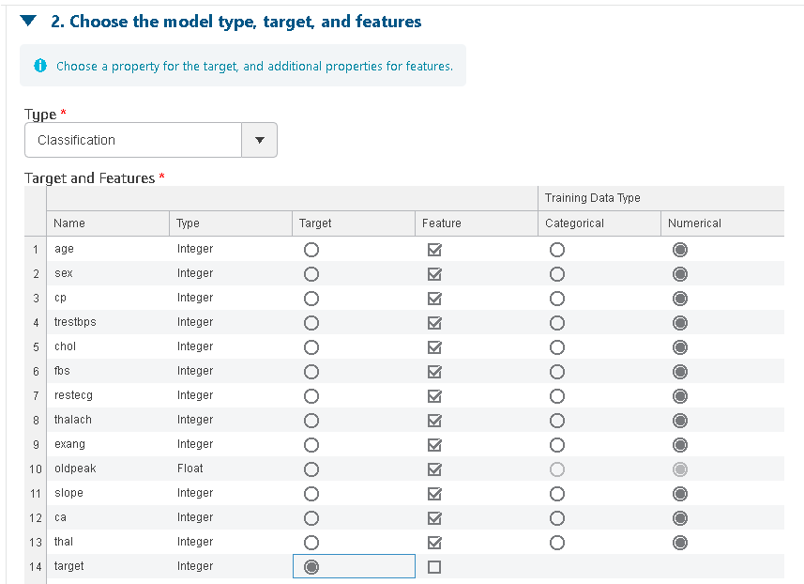
Modeling
In Machine learning workbench
Choose The dataset from the storage
Choose the model type , target ( the variable we want to predict )
and features (The variables used for predictions)
Notes:
AI is a computer science field that involves creating smart machines or systems that mimic human behavior , tackling tasks that typically require human intelligence. its the revolutionizing the way we work live , and interact .

Slide 16

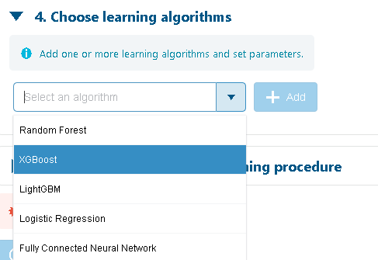

Choose The data Split :
Choose the percent of the dataset to be used as the training set. The remaining percent is used as the testing set. 5-fold cross-validation is performed on the training set to obtain validation metrics.
Choose The Learning algorithm (in this case we will use
random Forest )
Hyperparameter tuning
Notes:
AI is a computer science field that involves creating smart machines or systems that mimic human behavior , tackling tasks that typically require human intelligence. its the revolutionizing the way we work live , and interact .

Slide 17
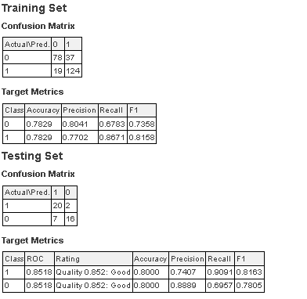
Train and test the Model
After Training the model this is the Model report where we can assess the performance of our model
Evaluation
Confusion Matrix : a table that helps visualize the performance of a classification model by summarizing the number of correct and incorrect predictions made by the model on a dataset.
Accuracy : Overall correctness of the model’s predictions ( The ratio of correctly predicted instances to the total number of instances )
Precision: Measures accuracy of positive predictions.
Recall: Measures ability to identify all positives.
F1 Score: Balances precision and recall.
Notes:
AI is a computer science field that involves creating smart machines or systems that mimic human behavior , tackling tasks that typically require human intelligence. its the revolutionizing the way we work live , and interact .

Slide 18
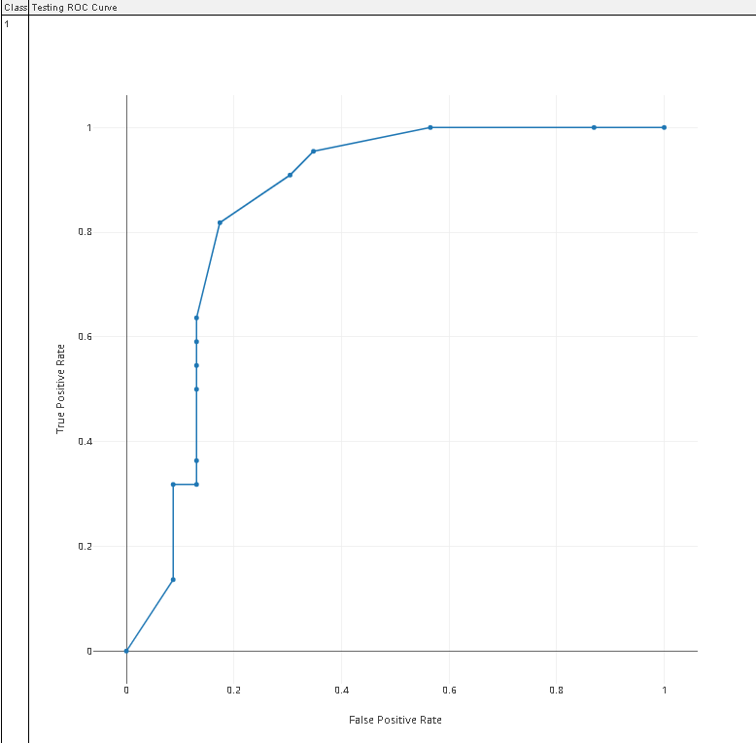
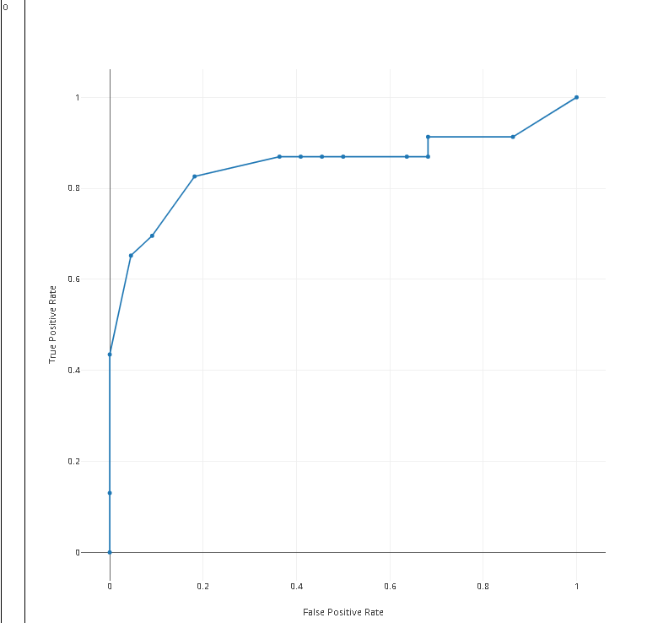
ROC Curve of the model : (Receiver Operating Characteristic) curve is a graph that shows how well a binary classification model can distinguish between two classes. It plots the true positive rate (correctly predicted positives) against the false positive rate (incorrectly predicted negatives) for different thresholds.
Notes:
AI is a computer science field that involves creating smart machines or systems that mimic human behavior , tackling tasks that typically require human intelligence. its the revolutionizing the way we work live , and interact .

Slide 19
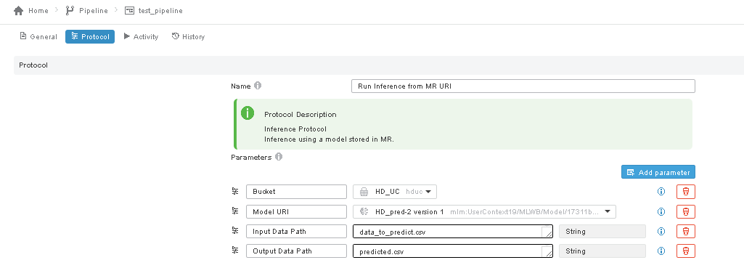
Prediction
In Data Factory studio , we define a new pipeline Pilot protocol that takes into input the prediction data ,uses the published machine learning model that we just created , and the output is a csv file containing the predicted data
Notes:
AI is a computer science field that involves creating smart machines or systems that mimic human behavior , tackling tasks that typically require human intelligence. its the revolutionizing the way we work live , and interact .

Slide 20
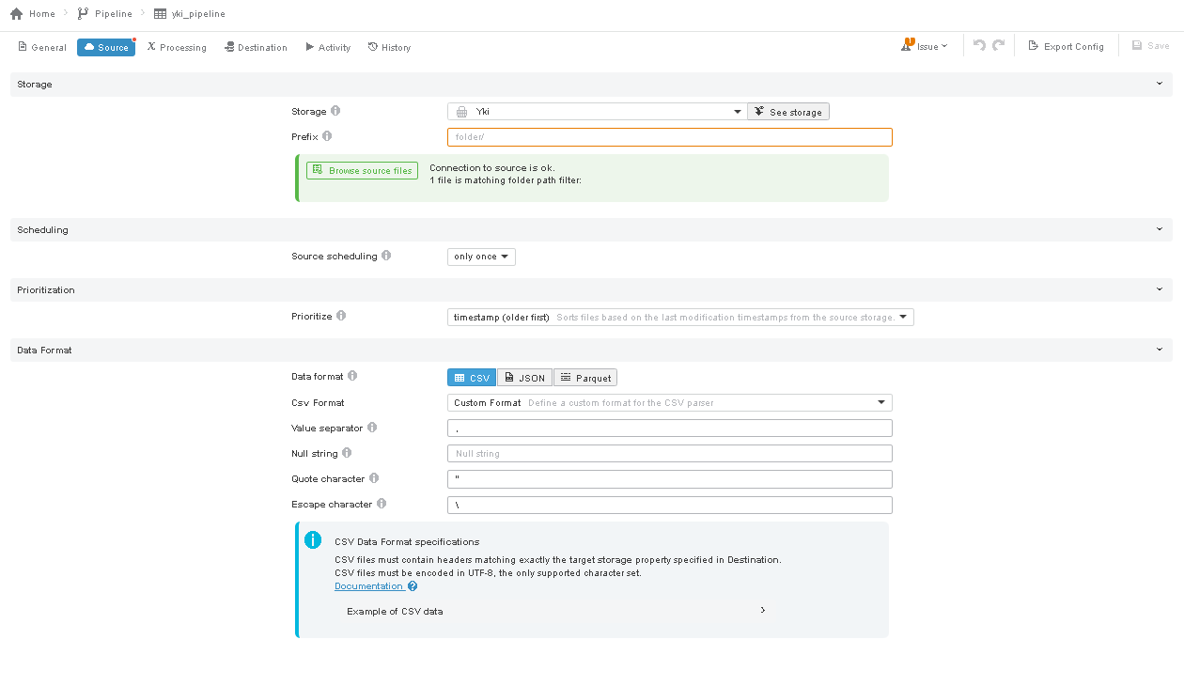
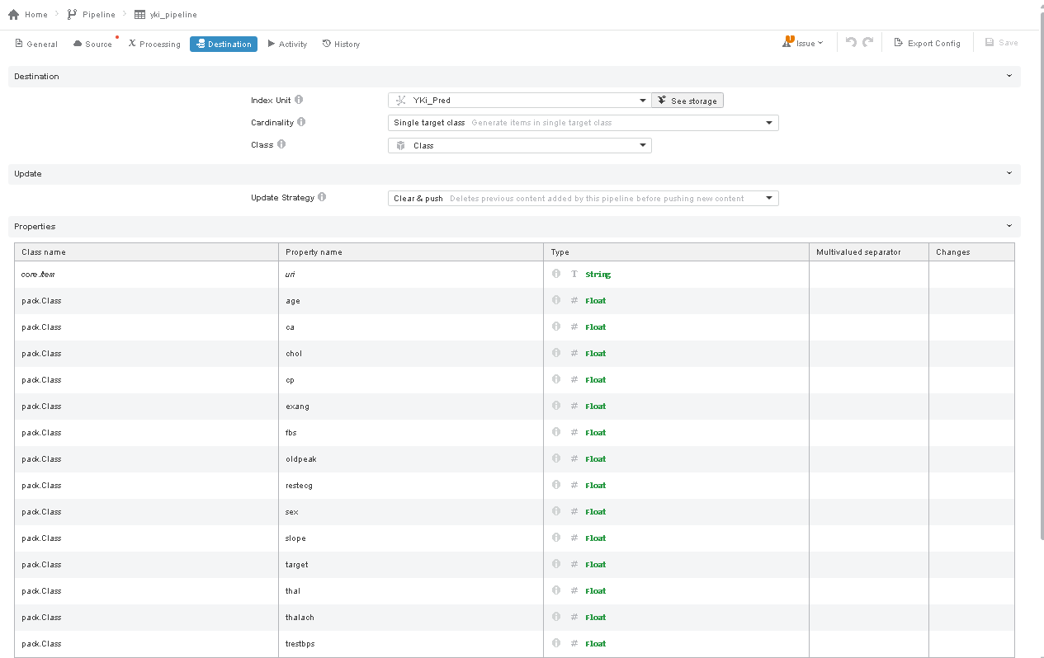
Visualizing results with Data Perspective
First I configured a pipeline that ingests data from data object storage ( generated by the prediction pipeline )
into semantic graph index so I can use it in Data perspective studio .
Notes:
AI is a computer science field that involves creating smart machines or systems that mimic human behavior , tackling tasks that typically require human intelligence. its the revolutionizing the way we work live , and interact .

Slide 21
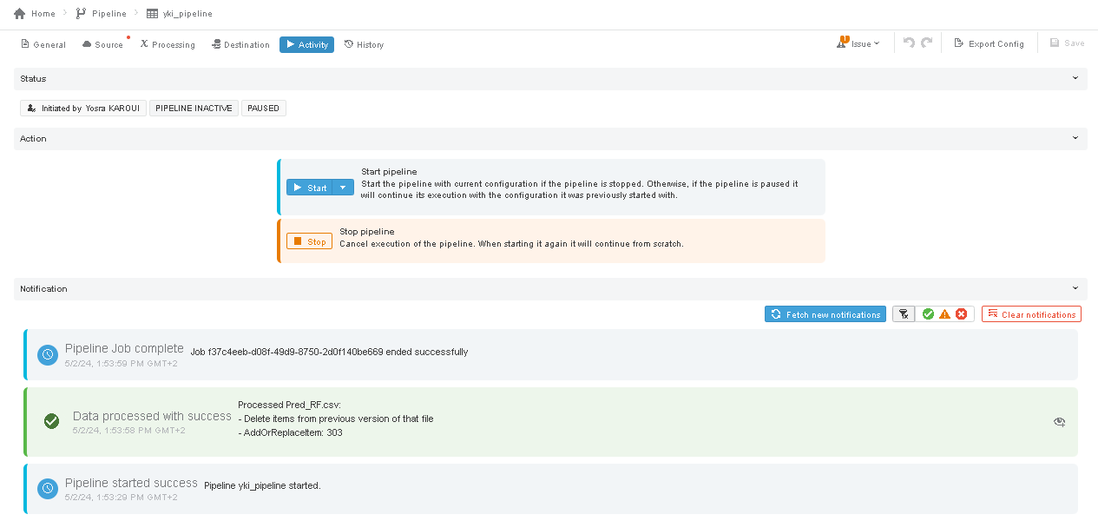
Notes:
AI is a computer science field that involves creating smart machines or systems that mimic human behavior , tackling tasks that typically require human intelligence. its the revolutionizing the way we work live , and interact .

Slide 22
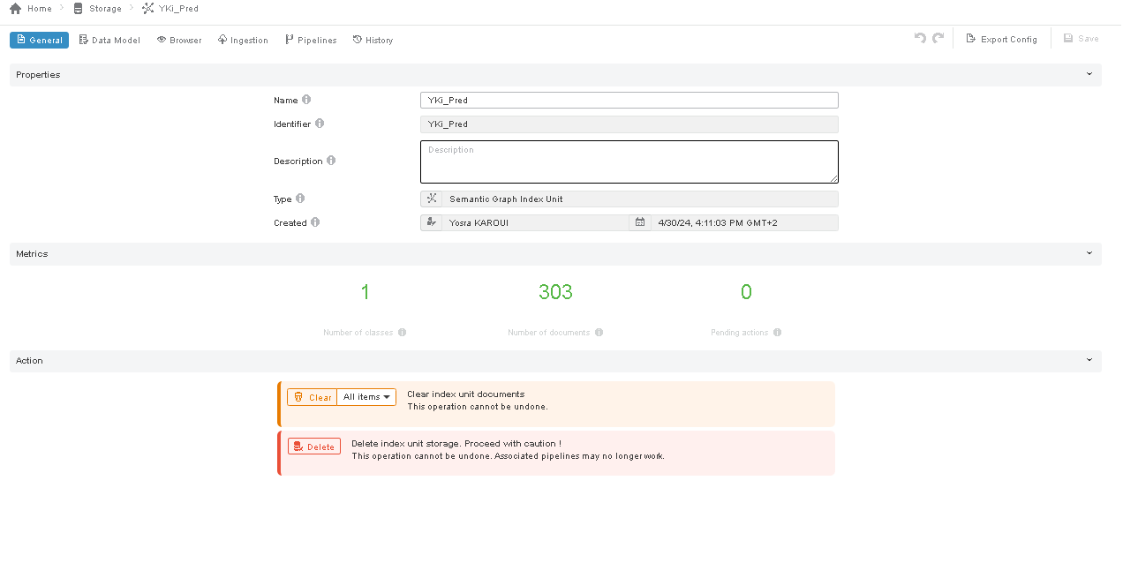
Notes:
AI is a computer science field that involves creating smart machines or systems that mimic human behavior , tackling tasks that typically require human intelligence. its the revolutionizing the way we work live , and interact .

Slide 23
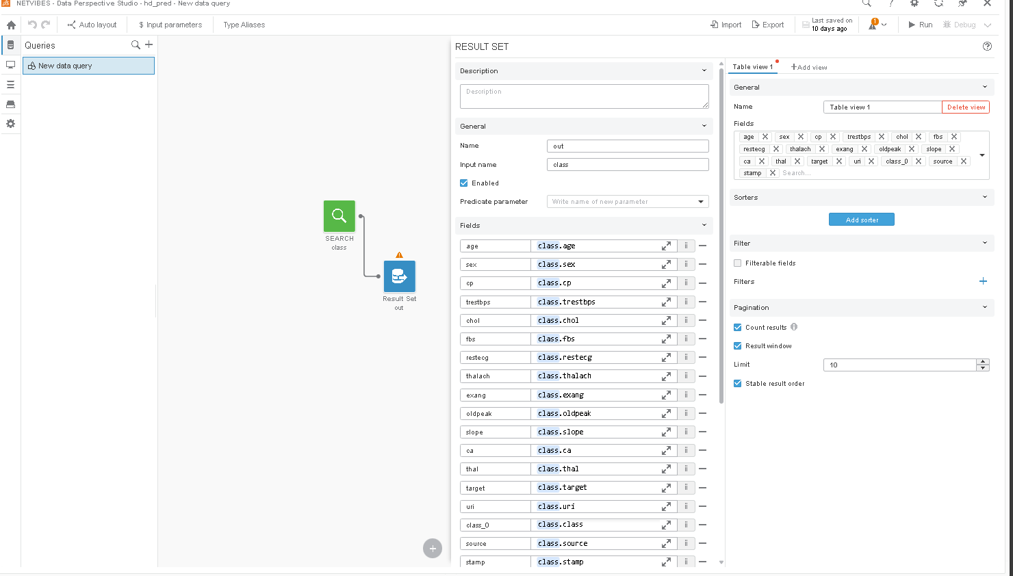
After ingesting our predicted data into SGI , we can use it to visualize the result on data perspective studio .
we start by defining the query :
Notes:
AI is a computer science field that involves creating smart machines or systems that mimic human behavior , tackling tasks that typically require human intelligence. its the revolutionizing the way we work live , and interact .

Slide 24
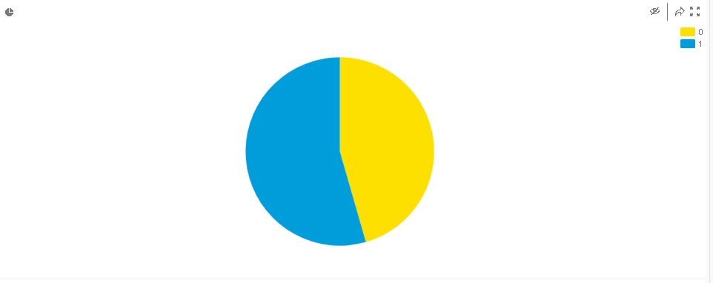
0 : Number of people with no Heart Disease
1 : Number of people with heart Disease
Notes:
AI is a computer science field that involves creating smart machines or systems that mimic human behavior , tackling tasks that typically require human intelligence. its the revolutionizing the way we work live , and interact .

Slide 26







